Slide 1
Mobile Application Development
Types of Mobile Applications

Slide 2
Types of Mobile applications
There are three types of mobile applications
1. Native applications
2. Web applications(mobile web site)
3. Hybrid applications

Slide 3
1. Native applications
Native applications are built specifically for each mobile platform and installed on the device itself.
Each native mobile app only works on the platform for which it was built.
If you want native apps to work across all mobile platforms, you must build separate versions for each platform.
There are three main 3rd Generation Object-Oriented Languages that are used for developing Native applications.
1. Object C for IOS platform Native applications
2. Java for Android and black berry RIM platform
3. C# for Windows phone Native applications

Slide 4
Advantages of Native applications
It can access the on-board hardware and software on a mobile device. For example it access onboard hardware such as GPS, camera, microphone and graphics. It can also access onboard softwares such as email, calendar, contacts, picture/video gallery, file manager, and home screen widget areas.
2. Has the ability to run offline: Since the application remains installed on the device from the original download, no internet connection is required.

Slide 5
Disadvantages of Native apps
Applications cannot work across different mobile platforms. For a native app to work across multiple devices, separate versions of the app are required.
It requires extra money and effort to develop, testing, and distribution for different versions to various platforms rather then simply developing one version for all platforms or updating a single website.

Slide 6
Examples of Native Applications
There are Several examples of native mobile applications
1. SMS applications
2. USSD Applications
3. Content Based Applications

Slide 7
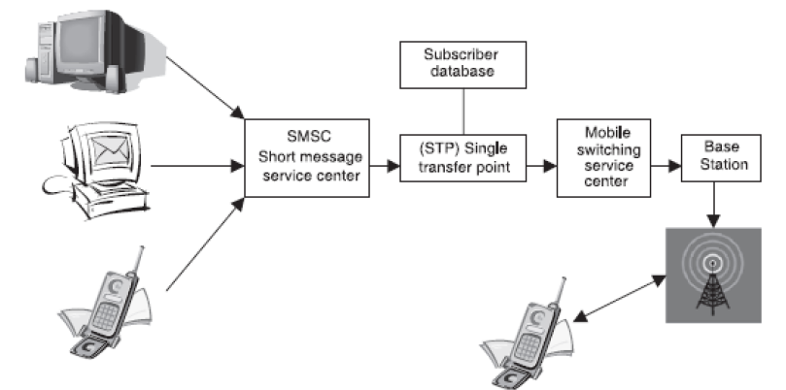
1. Short Messaging service(SMS) Applications
Short Messaging service(SMS) Applications are used for transferring short, usually a 160 character text, message to other mobile phone users over a cellular network.

Slide 8
1. Short Messaging service(SMS) Applications
SMS is used in business communications such as banking and individual communication .
SMS provides a store and forward system which makes it possible for the message to be stored in a telecom operators infrastructure until the receiver is ready to accept it.
SMS can be received at any time even while a phone call is in
progress.
SMS provides a low cost non-voice communication system

Slide 9



Examples of free android SMS applications
Chomp SMS is an android based application features such as emoticons, widgets, quick reply pop ups, and blocking SMS from unwanted numbers.
EvolveSMS app contains features such ability to swipe between conversations which makes texting with a lot of people easier than hitting the back button and then selecting another conversation. It also has Android Wear support, password support for security, customizable notifications, and more
Handcent is packed with features including theme support, built-in spell checking, password protection for individual conversations to keep prying eyes away, group chatting, and more_x000b_

Slide 10
2. Unstructured Supplementary Service Data(USSD) Apps
USSD applications are menu based applications that use USSD protocols to create a real time connection between mobile devices and service provider’s computers to allows two-way interaction.
This is achieved by creating a session to sending pre-defined codes. For example *144# can be used to check the balance of a prepaid airtime account.
The code differs from the number to which an SMS is sent because it includes the symbols # and *.

Slide 11
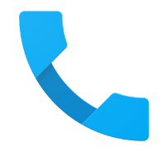
Example of USSD Apps
Default Phone app (or dialer) is an app that contain features like sending USSD codes, call blocking and voice mail.
Every mobile phone has its own version of Default Phone which is inbuilt.

Slide 12
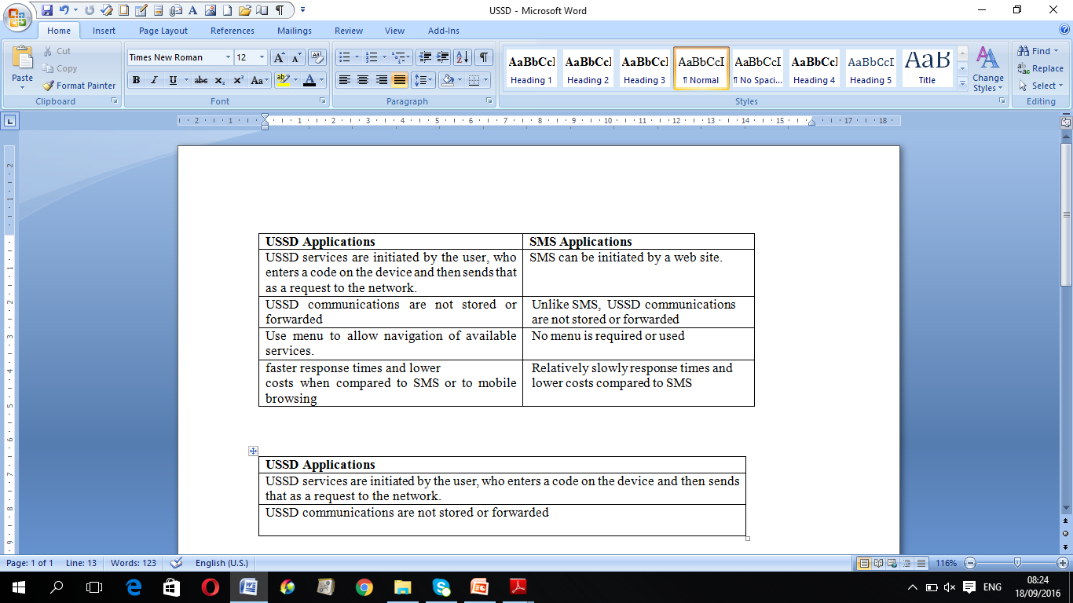
USSD vs SMS applications
Differences between USSD and SMS applications
Similarities of USSD and SMS applications
1. Both don’t require internet connection
2. Both are installed on mobile devices
3. Both are used for sending text based content

Slide 13
Case study in Kenya: Mpesa
M-Pesa is a mobile money-transfer application that was created in Kenya in 2007 to allow urban workers to send money home to their rural families, who had little or no access to banking or postal services, but who owned or could access a mobile phone.
Since the money is transferred using USSD and confirmed through SMS.
No Internet access is required either.
M-Pesa has been so successful in Kenya that is has over 10.5 million active monthly subscribers, who have transferred over $5.9 billion (between October 2012 and March 2013) through 65,547 registered agents around the country (Safaricom, 2013).
M-Pesa has been rolled out to several sub-Saharan Africa and Asia.

Slide 14
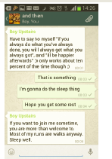
3. Instant messaging (IM) Applications
Instant messaging (IM) applications makes it possible for people to exchange messages in real time through internet.
IM applications are available to users who own smartphones and internet enabled feature phones.
Examples : BlackBerry Messenger, WeChat, WhatsApp, Google Talk and Skype.

Slide 15
3. Instant messaging (IM) Applications
From a marketer’s point of view, instant messaging applications (IM) can offer a channel for customer support, but presents even more of a risk in terms of alienating or angering consumers.
This is a space reserved for personal contacts. That said, instant support gives you the chance to reach customers when they are focused on your service or product.
This relies on the assumption that you are available to provide the information needed instantly.

Slide 16
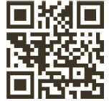
4. Quick Response(QR) Codes Applications
Also known are scannable barcodes that can be read by certain mobile applications (by taking a photo of the barcode). They contain information such as a URL.
QR codes, also called 3D barcodes, offer a way to compress complex information into an image that can be decoded by your mobile phone.
QR codes can offer users with camera phones a convenient way to get information with just one click.
Once you have installed a QR code reading app, these barcodes can be interpreted by the phone’s camera to provide website URLs, contact information, discount vouchers, or even to activate downloads.
An Example of The QR code

Slide 17
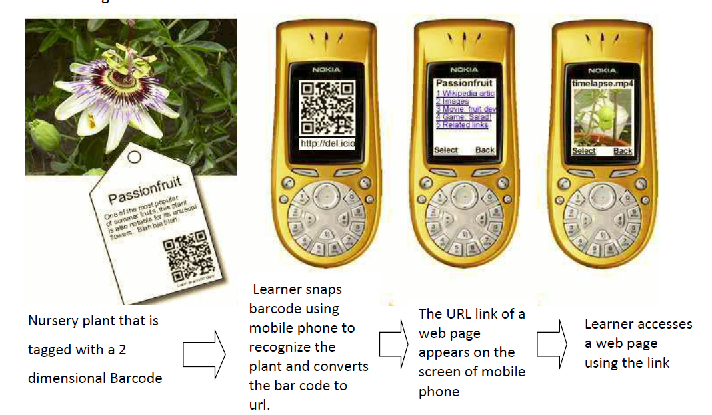
4. Case of QR codes Applications
Leonard Low and Margaret O’Connell (2006) application captures barcodes that are tagged on a nursery plant. The captured bar code is then translated into a web link, which appears on the screen of the learner's mobile phone. The web link is used to access Information about the nursery plant as indicated in Figure 2.13.

Slide 18
2. Web applications
A mobile web application is a mobile website that is formatted for use on a mobile device (e.g. smartphone or tablet) and accessed through the device’s web browser.
Example: apps.ft.com/home/web-app
A mobile web app is normally downloaded from a central web server each time it is run. Although apps built using HTML5 can also run on the mobile device for offline use.
Web application is not limited to one development language. It can be developed in any language such as Java, PHP, Python, etc…

Slide 19
Technologies for Web Applications
(a) Technologies: A mobile web app is developed using three core technologies:
1. HTML defines static text and images
2. Cascading Style Sheets (CCS) defines style and presentation
3. JavaScript defines interactions and animations.

Slide 20
Advantages of Web Applications
1. The key advantage of mobile web apps over native mobile apps is cross-platform compatibility, allowing them to reach the broadest audience for the least effort.
2. They’re relatively cheap, easy, and fast to build, mobile web browsers are fairly standardized, making it much easier to create a universal mobile web app than a native one.

Slide 21
Tools For Developing Web Apps
(There are multiple tools that can be used to develop web
applications in minutes.
The tools provides development environment with facilities to
select original desktop site, previewing how the web app looks
on different devices, and fine-tuning for each device.
Examples are:
Wapple (http://wapple.net/)
mobiSiteGalore http://www.mobisitegalore.com
MobilePress http://mobilepress.co.za
MobileFrame (http://www.mobileframe.com/)
Pyxis (http://www.pyxisportal.com/

Slide 22
1. Wapple (http://wapple.net/)
Wapple describes itself as "the most advanced mobile web build, development and publishing technology“ .
It can be used to create very sophisticated mobile websites and have them up and running in less than 30 minutes.
Its features include click-to-call, polls, questionnaires, a mobile shop, built-in forms, analytics, social media, video and Google maps integration.

Slide 23
2. mobiSiteGalore http://www.mobisitegalore.com
MobiSiteGalore has a free limited trial service that allows setting up a website with three pages and limited features and hosting,
It also offers Professional package with unlimited pages for just $225 a year.
mobiSiteGalore consists several features that be used to create some very sophisticated mobile websites.
It include the following features:
1. Widgets to do site search, add Google News and Sitemap
2. Click-to-call features
3. Ecommerce features e.g. ability to accept PayPal or Bango payments
4. Design features including photo galleries
5. Multimedia features for adding audio and video clips.

Slide 24
MobilePress http://mobilepress.co.za
MobilePress is a free WordPress plugin that to allow access to WordPress website on mobile handsets, with the ability to use customised themes.
It has features for tracking mobile sites analytics and serve advertisements from some of the biggest mobile ad networks such as Admob, Quattro Wireless, Buzzcity and InMobi.
Developers can also include their own advertisements.

Slide 25
Examples of Mobile Web Apps
Examples of such application are:
- Wikipedia Mobile (http://en.m.wikipedia.org/)
- Facebook Mobile (http://m.facebook.com)
- BBC News mobile (http://www.bbc.co.uk/mobile/index.html)

Slide 26
Disadvantages of web apps
Web apps generally cannot access the on-board hardware and software on a mobile device. Requirements such as camera control, direct GPS control (there is limited access to current location) .
It cannot support heavy/complex custom graphics (gaming, etc.)
Web apps generally require a network connection to function, with performance issues if the website is slow or unavailable.

Slide 27
Native vs Web Applications
The biggest difference between the two types :
Native applications are installed directly on each device while web applications are served from a central location and
Accessed through a web browser without requiring installation on each device, they are platform independent.

Slide 28
Hybrid Apps

Slide 29
3. Hybrid applications
Hybrid apps combines (blends) native and web apps to allow the
user interface appears in a browser window, with a native app
wrapped around it.
This means hybrid application is native Application with Web
Application inside it.
Advantages:
1.The application can access device functionality(onboard software and hardware) that is not available through the browser.
2. Reduce development time, cost by allowing minimal customizing to reuse it across different devices.
Disadvantage:
1. They it requires customizing by writing at few codes to allow reusing it across different devices

Slide 30
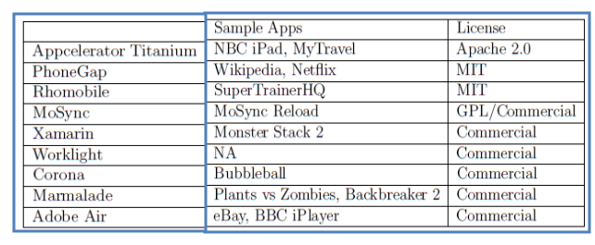
Tools for Creating Hybrid Apps
There are several tools that can be used to develop Hybrid Apps.
They include the following:
Other Tools: Intel XDK

Slide 31
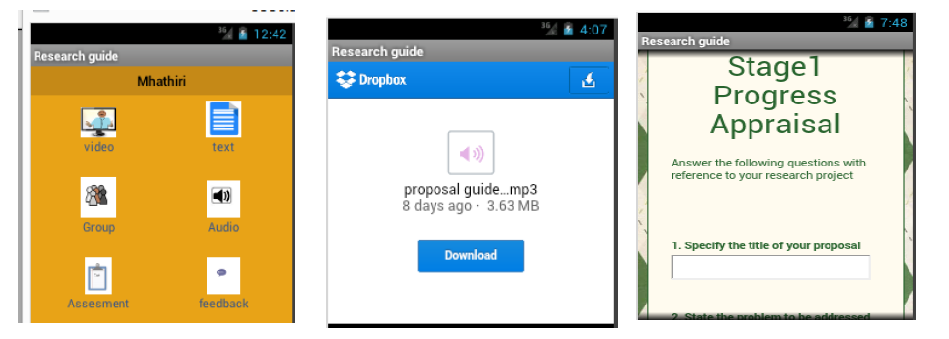
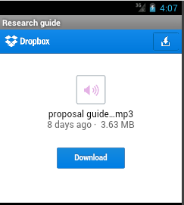
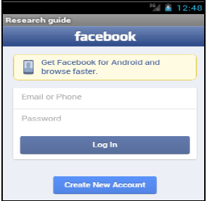
Case of Hybrid Mobile Applications
An Example is OMAL application (Mwendia and Buchem,2013) ,
that consists of native mobile module, which wraps other mobile web applications like dropbox and facebook to enable accessing of learning materials by university students.

Slide 32
Native vs Hybrid apps
To the user, a well-designed hybrid app looks very similar to a native app: it is downloaded from an app store, stored on the mobile device, and launched just like a native app
But to developers there is a huge difference, because rather than rewriting the entire app for each mobile platform, they write at least some of the code in HTML, CSS, and JavaScript, and reuse it across different devices

Slide 33
Hybrid apps vs Web Apps
Both web apps and hybrid apps web app can work across different platforms.
Hybrid app can access onboard hardware and software of the device. However, web app cannot access such functionality since they are not available through the browser.

